Slide 1
Mom’s computer
By Jordan Lemite

Slide 2
Project objectives
Address the Issue
Expose the risks through a penetration test
Explain the importance of the security vs convenience tradeoff
Provide ways to ensure better practices

Slide 3
The issue
Use of unsupported windows OS
Months of uninstalled updates
Carelessness with storage of sensitive data
An improper balance between convenience vs security

Slide 4
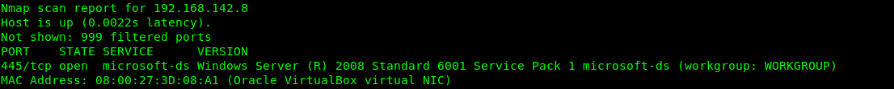
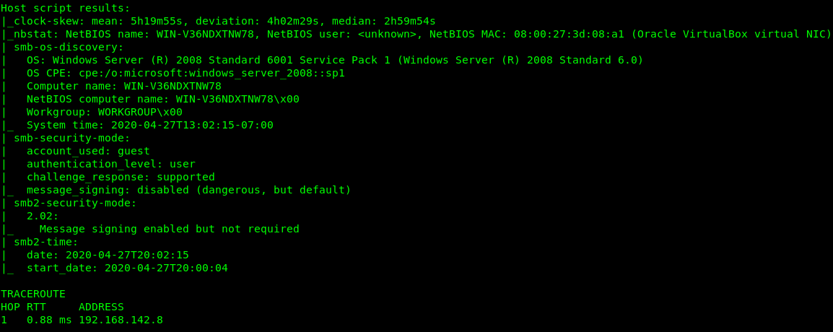
The test: reconnaissance
Performed two Nmap scans
host discovery ( -sv)
Vulnerabilities and system information (-v -sV -O)

Slide 5

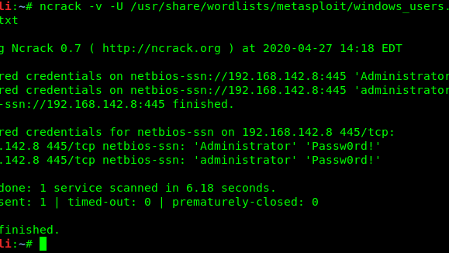
The test: Brute Force
Created two wordlists
Ran an ncrack scan on the vulnerable port
Scan finished quickly due to the weak password

Slide 6
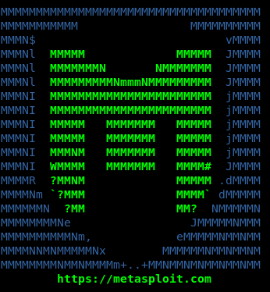
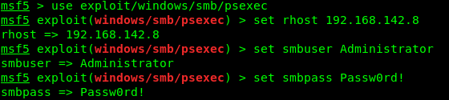
The test: the exploit
Metasploit Framework
Smb exploit with psexec

Slide 7
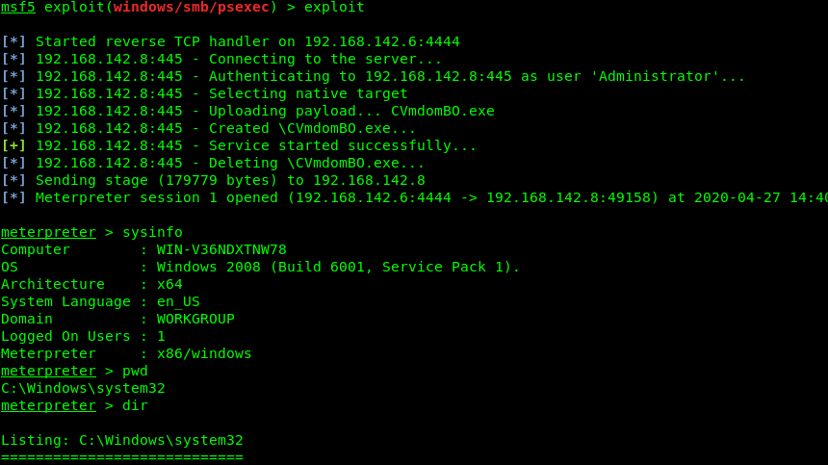
The test: “I’m in”
Meterpreter
Session created
Granted terminal access in system 32 directory
Full administrator access
Account creation
Firewall control
Program sniffing
Hash dumping

Slide 8
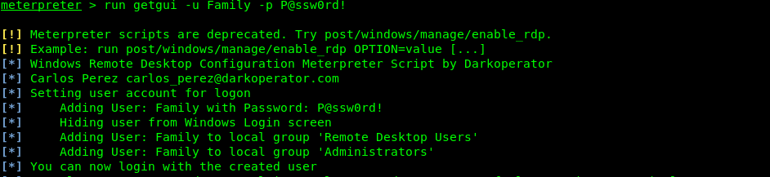
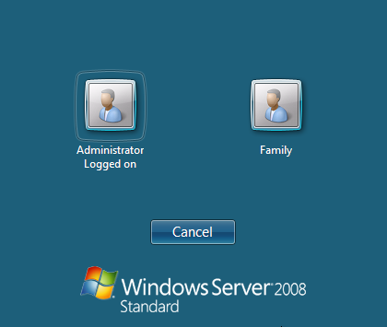
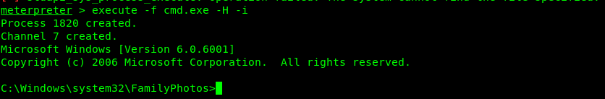
The test: “I’m in” continued
FAMILIAR ACCOUNT NAME
SPAWNED SHELL
WINDOWS COMMANDS VS METERPRETER

Slide 9
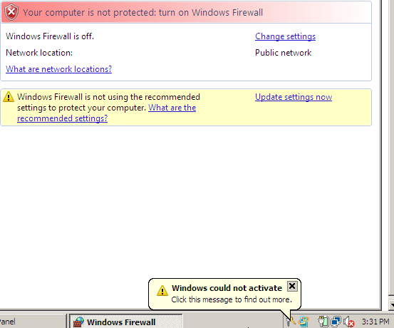
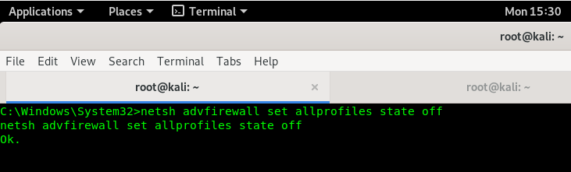
The test: the firewall
the Firewall is not perfect
There are ways to bypass it
Not having a firewall Puts others at risk
Malware
125% increase in windows EOL targeting
360% growth in Ip addresses tied to windows exploits

Slide 10
The test: keylogging
Keyloggers are simple to create
Meterpreter sniffs specific programs to capture keystrokes
Keylogging can be undetectable
Great way to get additional data

Slide 11
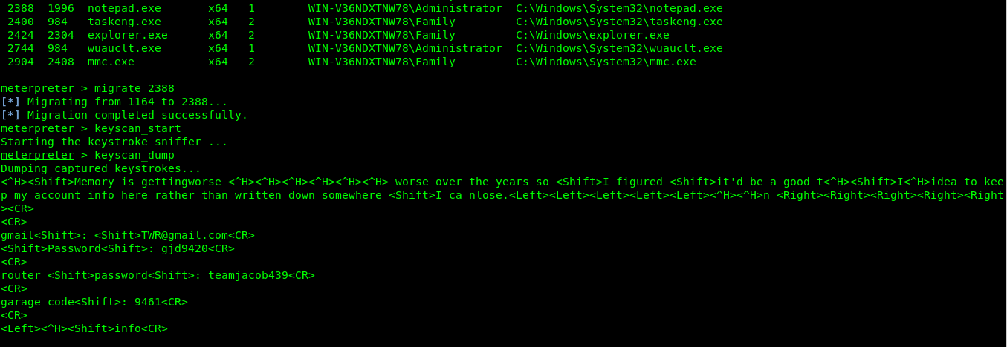
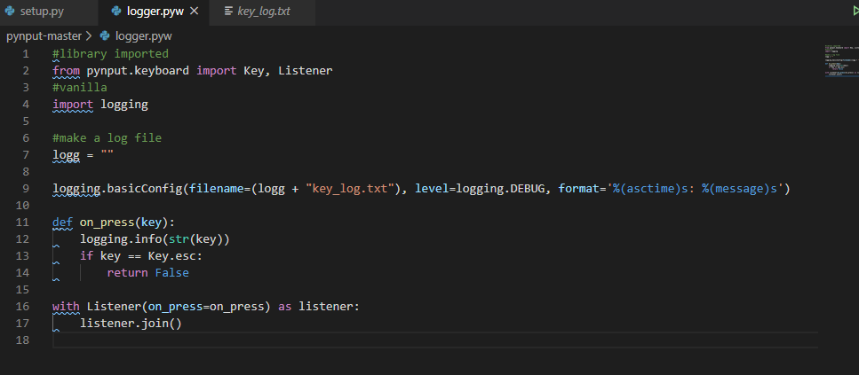
The test: keylogging continued

Slide 12
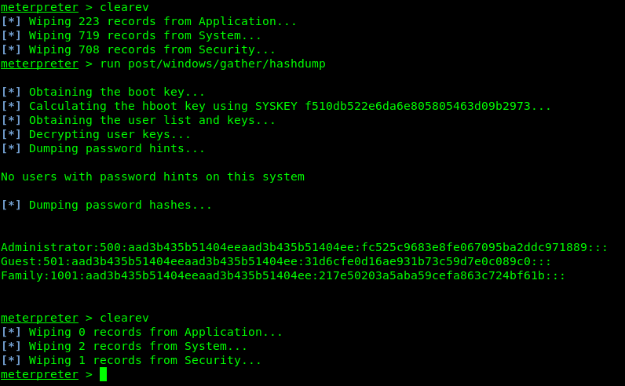
The test: wrapping up
Hash dumping
Get the other account credentials
Idle time
Zero user activity during the test
Log clearing
No traces
Firewall reactivation
Important in order to be undetected

Slide 13
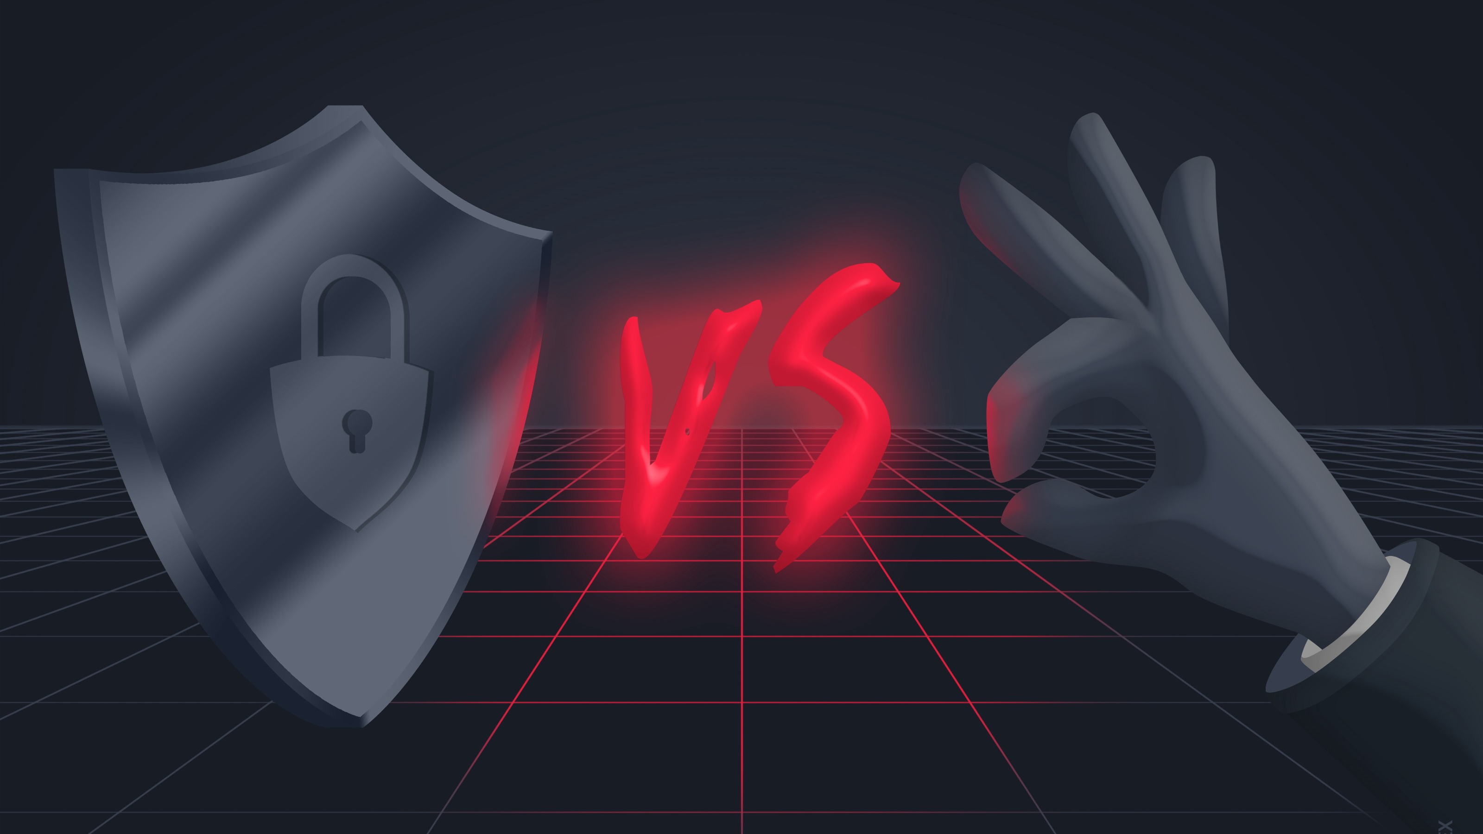
Security vs convenience
Security is important yet so is ease of access
It is important to find a healthy balance
with more security we lose functionality of everyday processes
With more convenience we create more risk than is necessary

Slide 14
Better Practices
Upgrade to windows 10 and schedule updates
Previous versions have reached the end of their life
Updates can install automatically outside of user usage times
Don’t store passwords in text files
Choose easier to remember passwords
Antivirus
Minimize the risk of infection
Daily scans
Shutdown your computer When finished for the day

